Slide 1
INSERT

Slide 2
INSERT
WHICH TYPE OF SQL STATEMENT
????????

Slide 3
WHY INSERT ????

Slide 4
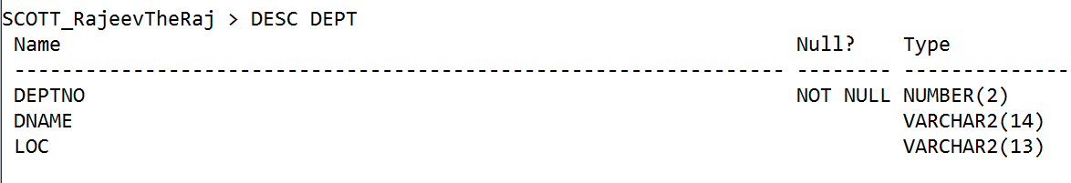
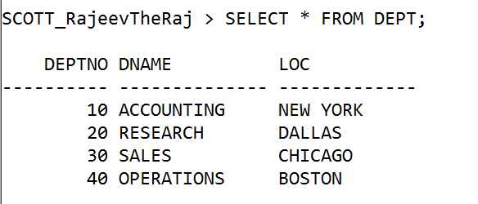

Slide 5
Use the INSERT statement to add new rows to a table.
For you to insert rows into a table, the table must be in your own schema or you must have INSERT privilege on the table.
If you have the INSERT ANY TABLE system privilege, you can also insert rows into any table or any view's base table

Slide 6
SYNTAX :
INSERT INTO table_name [COLUMN_LIST]
VALUES (COLUMN_VALUE);

Slide 7
COLUMN_LIST :
COL1, COL2, COL3 …
COLUMN_VALUE (OR values_clause):
VAL_COL1, VAL_COL2, VAL_COL3 ….

Slide 8
You must specify a value in the values_clause for each column in the column list.
If you omit the column list, then the values_clause must provide values for every column in the table.

Slide 9
DATATYPE :
  NUMBER
  CHAR, VARCHAR2
  DATE, TIMESTAMP
  BOOL

Slide 10
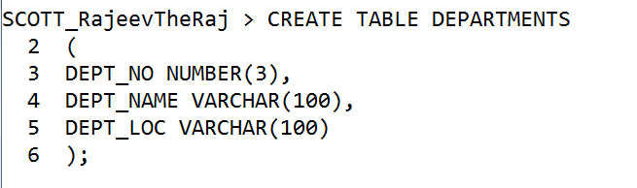

Slide 11
The following statement inserts a row into the sample table departments:
INSERT INTO departments(deptno,dname, dloc) VALUES (80, 'Recreation', ‘BBSR’);
Character and date values are enclosed within single quotation marks.

Slide 12
Inserting Values without specifying column names
INSERT INTO departments VALUES (80, 'Recreation', ‘BBSR’);
Values for all the columns must be given.
The datatype of the column must match with the values.

Slide 13
The following statement inserts a row with five columns into the employees table. One of these columns is assigned NULL and another is assigned a number in scientific notation:
INSERT INTO employees (employee_id, last_name, hire_date, job_id, salary, commission_pct)
VALUES (207, 'Gregory', SYSDATE, 'PU_CLERK', 1.2E3, NULL);

Slide 14
To assign implicit NULL values omit the column from column list:
INSERT INTO employees (employee_id, last_name, hire_date, job_id, salary)
VALUES (207, 'Gregory', SYSDATE, 'PU_CLERK', 1.2E3);
In the above example the column commission_pct is omitted from the column list.

Slide 15
If the departments table had been created with a default value of ‘US’ for the dloc column, you could issue the same statement as follows:
INSERT INTO departments (deptno, dname, dloc) VALUES (80, 'Recreation', DEFAULT);
INSERT INTO departments (deptno, dname) VALUES (80, 'Recreation');

Slide 16
Adding rows from another table
The following statement copies employees whose commission exceeds 25% of their salary into the bonuses table
INSERT INTO bonuses
SELECT employee_id, salary*1.1
FROM employees
WHERE commission_pct > 0.25 * salary;
The number of columns and their datatypes in the column list of the INSERT clause must match the number of values and their datatypes in the select clause.

Slide 17
Using substitute variable Example
Use & substitution to prompt for values.
& is a placeholder for the variable.
INSERT INTO departments
VALUES (&DeptNo, ‘&Deptname’, ‘&loc’);

